Slide 1
ICE Proposal Wireframes
Version 11
9/7/2018

Slide 2
Purpose
Screen mockups to aid development ahead of an agile Scrum event
4 primary user types (see personas next slide)
Training portal

Slide 3
Personas
System Administrator
Full: Login, CRUD on users, skills, offices, supervisors
Special Agent
Limited: Login, alerts, view my training
Supervisor of Special Agent(s)
Extended
Senior Leader (D4 and above)
Extended

Slide 4
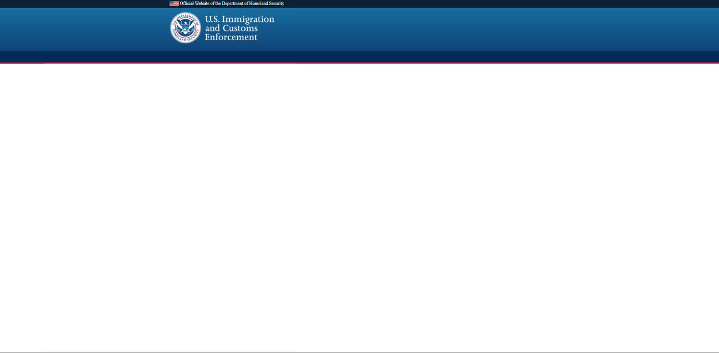
Shown Below is Login Screen across Roles
Homeland Security Investigations
Training Portal
Welcome to the ICE HSI Training Portal. Please log-in using your credentials below.
User ID
Password
I forgot my username or password
Login
Notes:
HSI badget

Slide 5
Shown Below is Login Screen for System Administrator
Homeland Security Investigations
Training Portal
Welcome to the ICE HSI Training Portal. Please log-in using your credentials below.
User ID
Password
I forgot my username or password
Login
After clicking Login button, then the Alert and Continue button Appear
ALERTS (1)
Firearms quarterly report due by 8/30/2018
Click Here to Run Report
Continue to Training Portal
Since no user story for this Alert box, the text is fixed and the Click Here button does nothing
Notes:
HSI badget

Slide 6
Shown Below is Login Screen for Special Agent
Homeland Security Investigations
Training Portal
Welcome to the ICE HSI Training Portal. Please log-in using your credentials below.
User ID
Password
I forgot my username or password
Login
ALERTS (1)
Your firearms qualification must be completed within 3 days
After clicking Login button, then the Alert and Continue button Appear
Request Training
Continue to Training Portal
Notes:
HSI badget

Slide 7
Shown Below is Login Screen for Supervisor Special Agent
Homeland Security Investigations
Training Portal
Welcome to the HSI ICE Training Portal. Please log-in using your credentials below.
User ID
Password
I forgot my username or password
Login
ALERTS (1)
The following agents have proficiencies expiring soon:
Derick Smith Firearms qualification Due 8/21/18
Lia Mya Firearms qualification Due 8/22/18
Al Unser Firearms qualification Due 8/22/18
After clicking Login button, then the Alert and Continue button Appear
Continue to Training Portal

Slide 8
Shown Below is System Administrator: Destination After Login
Homeland Security Investigations
Training Portal
Agent Info
System Administration
New Agent
Existing Agents
Allow dash in first or last name
First Name
*
Middle Initial
Last Name
*
Suffix
Role dropdown: System Owner, System Admin, Supervisory Special Agent, Special Agent
Role
*
User ID
*
Office Code
*
Drop downs for office and location sorted alphabetically
Location
*
User’s Supervisor
*
* Required field
Cancel
Save

Slide 9
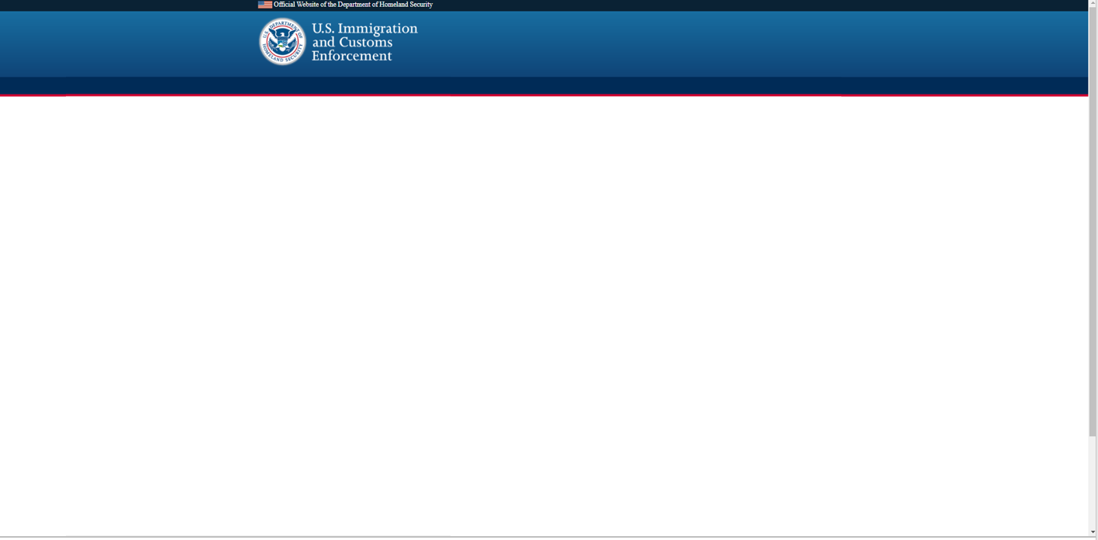

Shown Below is System Administrator: Destination After Login, Update Existing User Info
Homeland Security Investigations
Training Portal
Agent Info
System Administration
New Agent
Existing Agents
Find Agent
1. Admin searches for name.
2. Admin chooses name in table
3. Text boxes here display current info for agent clicked on in step 3.
4. Admin can change any info and click “Save.”
USER ID FIRST NAME MIDDLE LAST OFFICE CODE LOCATION
Edit Selected
First Name
*
Middle Initial
Last Name
*
Suffix
Role
*
User ID
*
Office Code
*
*
Location
*

Slide 10
Shown Below is System Administrator: Destination After Login, Update Existing User Info
Homeland Security Investigations
Training Portal
Agent Info
System Administration
New Agent
Existing Agents
Find Agent
1. Admin searches for name.
2. Admin chooses name in table
3. Text boxes here display current info for agent clicked on in step 3.
4. Admin can change any info and click “Save.”
USER ID FIRST NAME MIDDLE LAST OFFICE CODE LOCATION
UserID X First Middle Last #### Location
UserID Y First Middle Last ### Location
Edit Selected
First Name
*
Middle Initial
Last Name
*
Suffix
Role
*
User ID
*
Location
*

Slide 11
Shown Below is System Administrator: Destination After Login, Update Existing User Info
Homeland Security Investigations
Training Portal
Agent Info
System Administration
New Agent
Existing Agents
Find Agent
1. Admin searches for name.
2. Admin chooses name in table
3. Text boxes here display current info for agent clicked on in step 3.
4. Admin can change any info and click “Save.”
USER ID FIRST NAME MIDDLE LAST OFFICE CODE LOCATION
UserID X First Middle Last #### Location
UserID Y First Middle Last ### Location
Editing Selected
First Name
*
Middle Initial
Last Name
*
Suffix
Role
*
User ID
*
Location
*

Slide 12
Shown Below is System Administrator: Destination After Login, Update Existing User Info
Homeland Security Investigations
Training Portal
Agent Info
System Administration
New Agent
Existing Agents
Editing Selected
1. Admin searches for name.
2. Admin chooses name in table
3. Text boxes here display current info for agent clicked on in step 3.
4. Admin can change any info and click “Save.”
First Name
*
Middle Initial
Last Name
*
Suffix
Role
*
User ID
*
Office Code
*
Location
*
User’s Supervisor
*
Would probably scroll down the page, not within the tab pane as shown here
* Required field
Cancel
Save

Slide 13
Shown Below is System Administrator: Destination After Login, Edit Skills or Training
Homeland Security Investigations
Training Portal
Agent Info
System Administration
Edit Skills and Training
CATEGORY TYPE TRAINING (M)ANDATORY/
(D)ISCRETIONARY
Commercial License Driver License State Certification D
Commercial License Pilot License State Certification D
Language Spanish Agency Certification D
Firearms Glock 40 Agency Certification M
Click “+” to add table row.
Click “-” to disable (not remove) row.
Or edit text in table directly.
Hide Selected
Add Row
Cancel
Save

Slide 14
Shown Below is Special Agent: Destination After Login, Viewing Dashboard
Homeland Security Investigations
Training Portal
Special Agent Dashboard
Request Training
My Training and Education
Report Training Finish Date/Documentation
Submit Degree Info/Documentation
CATEGORY TYPE TRAINING M / D EXPIRATION
Will need a tooltip to spell out M/D
Commercial License Driver License State Certification D
Commercial License Pilot License State Certification D 08/21/2018
Language Spanish Agency Verification D 09/02/2018
Firearms Glock 40 Agency Certification M 07/31/2018
!
!
DEGREES / CERTIFICATIONS SCHOOL / INSTITUTION DATE EARNED
Masters of Science (M.S.) Georgia Institute of Technology 08/31/2010

Slide 15
Shown Below is Special Agent: Requesting Training
Homeland Security Investigations
Training Portal
Special Agent Dashboard
Request Training
My Training Request
Training Event
*
Training Type
Cost (Dollars)
*
*
Date Requested
MM
DD
YYYY
School/Institution
Preference
*
* Required field
Cancel
Save

Slide 16

Shown Below is Special Agent: After Clicking “Report Date Training Finished”
Homeland Security Investigations
Training Portal
Special Agent Dashboard
Request Training
Report Training Finish Date/Documentation
Date Finished
*
MM
DD
YYYY
Training Name
Documentation
*
* Required field
Cancel
Save

Slide 17
Shown Below is Special Agent: After Clicking “Submit Degree Info and Documentation”
Homeland Security Investigations
Training Portal
Special Agent Dashboard
Request Training
Submit Degree Information and Documentation
Date Finished
*
MM
DD
YYYY
Degree/Certification
*
School/Institution
*
Diploma/Certificate
*
* Required field
Cancel
Save

